Slide 1
coralseed scenarios
Part 1: Lizard Island simulations (Mermaid, Osprey, Palfrey)
Part 2: Interventions
i) enhanced larval competency
ii) enhanced localized retention
iii) time-delayed larval releases

Slide 2
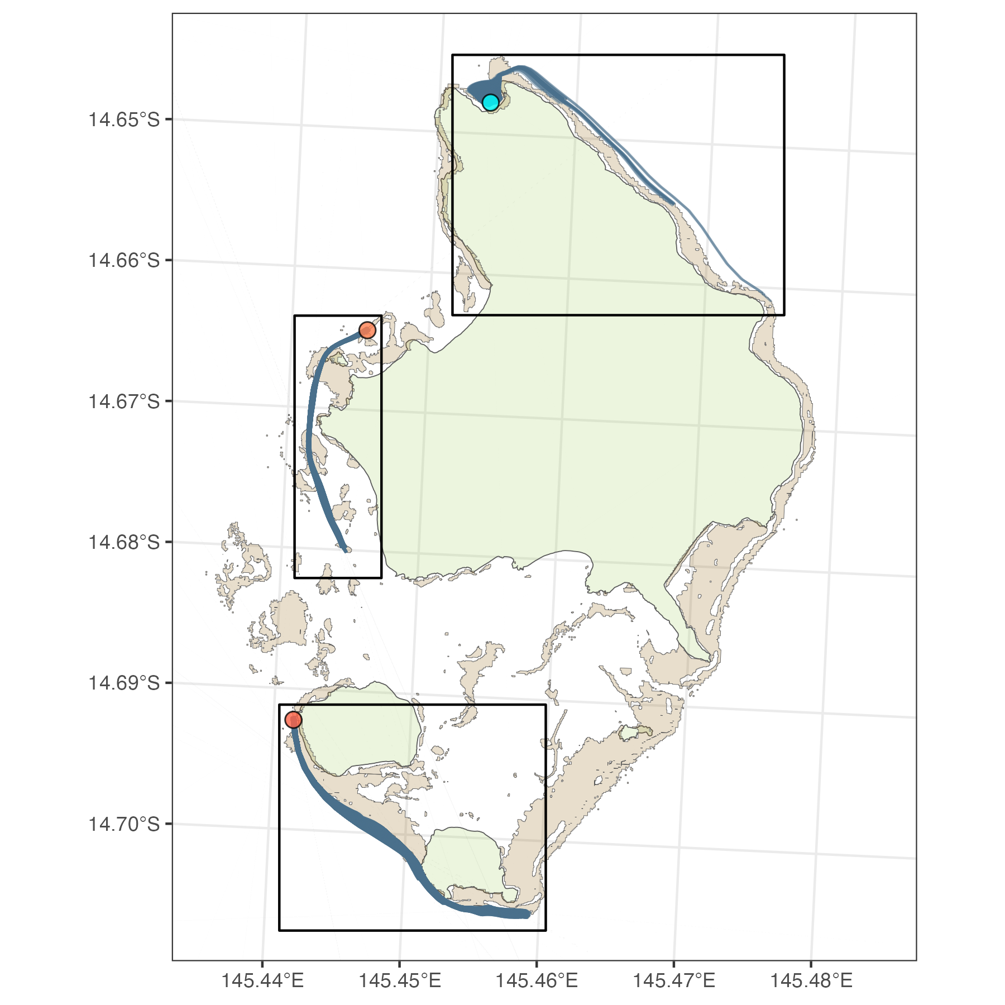
Part 1: Simulations
coralseed simulations
Mermaid Bay
1 million larvae released at three locations
Lizard Island, December 2022
Contrasting environments:
i) sheltered bay (Mermaid Reef),
ii) sheltered forereef (Osprey Reef),
iii) exposed forereef (Palfrey Reef)
1ha restoration area surrounding each release site
Larvae tracked for 12 hours
Osprey Reef
coralseed settings:
20% exogenous mortality
Type II mortality curve
Exponential settlement
Palfrey Reef

Slide 3
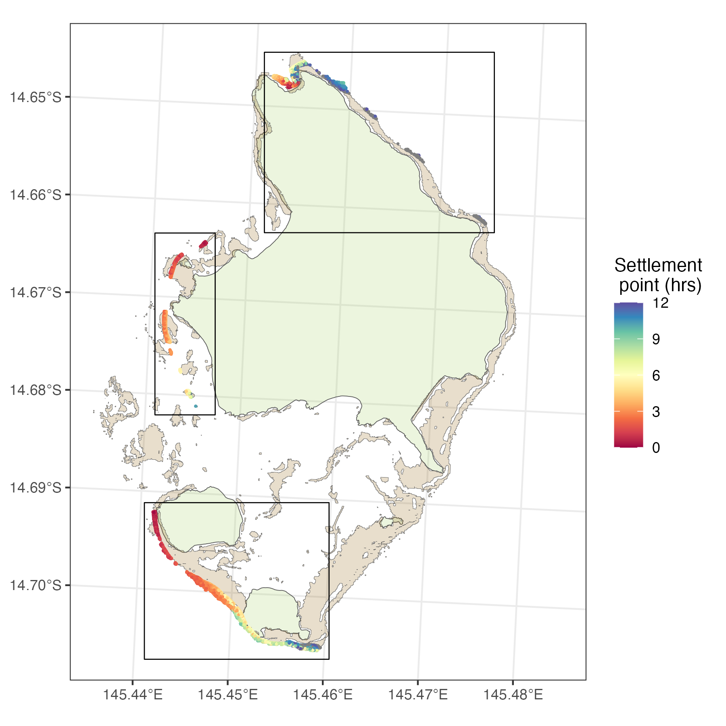
Part 1: Simulations
Spatially mapping settlement
Mermaid Bay
Where do 3 million larvae go?
Osprey Reef
Highest retention and settlement at mermaid but broad settlement spillover >9hrs after release
Early settlement at Osprey across isolated reef patches
Continuous settlement across Palfrey
Palfrey Reef

Slide 4
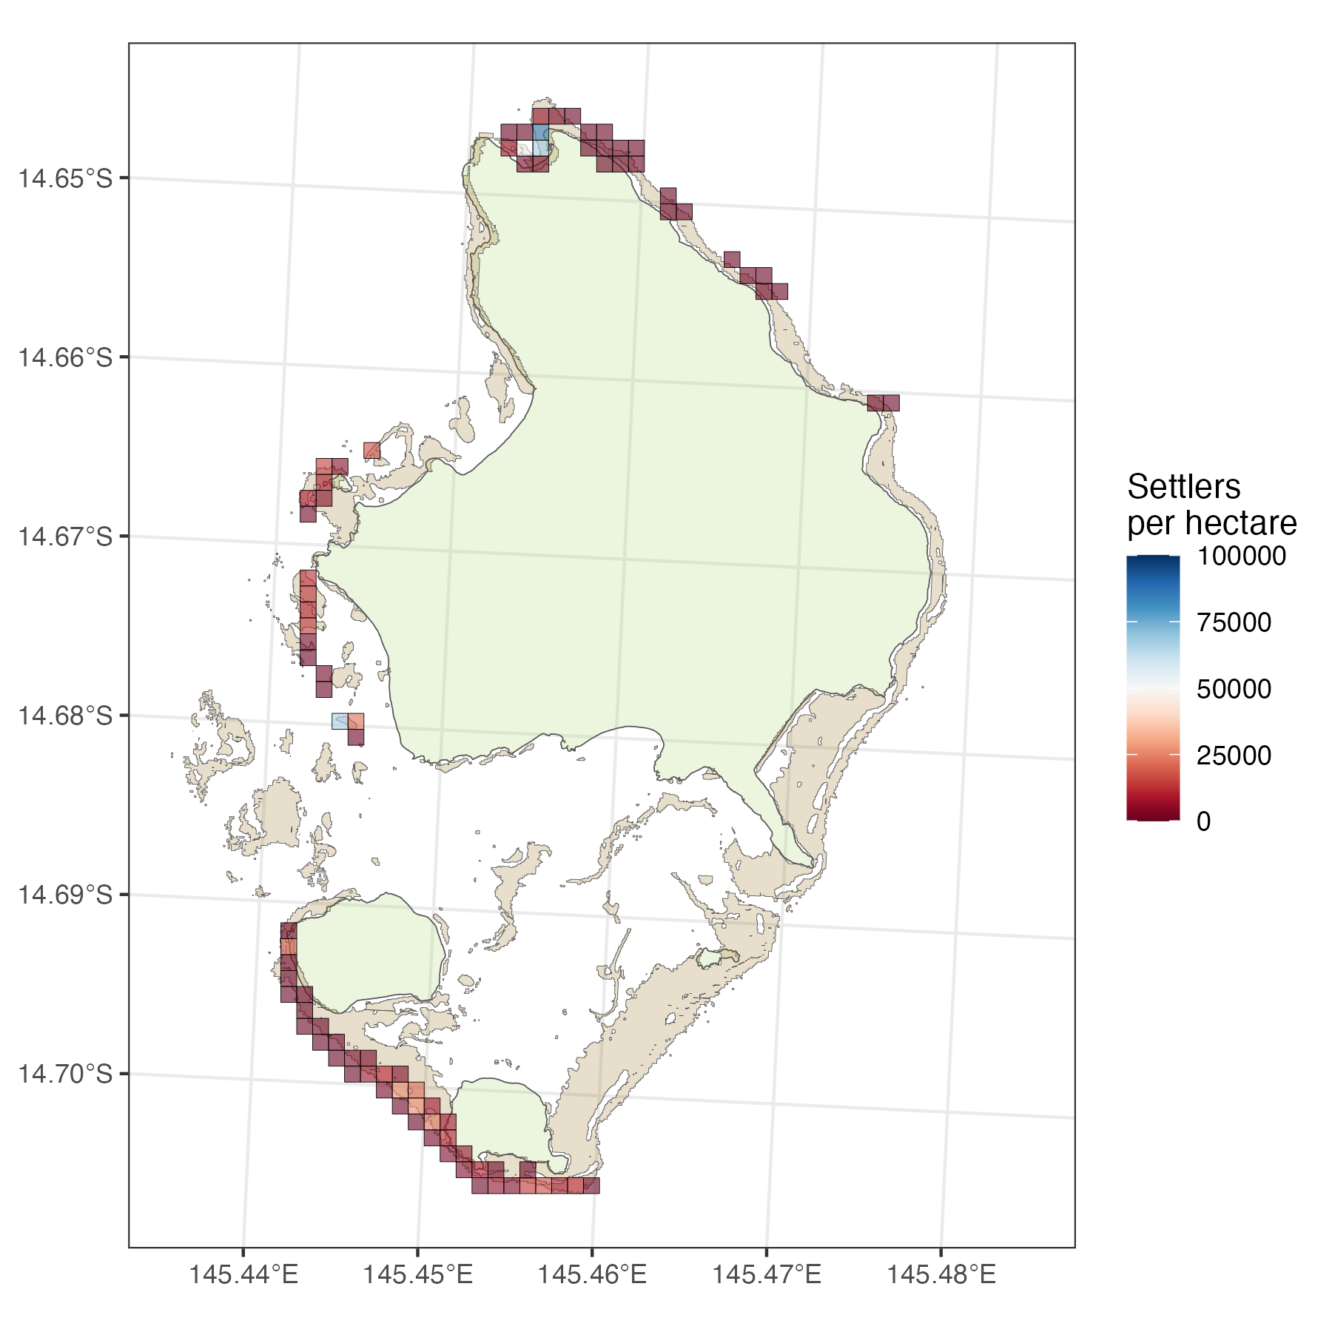
Part 1: Simulations
Settlement per hectare
Mermaid Bay
Plot size = 20*20m2
Maximum density within plots: 106 settlers per m2
Required density: 3000 settlers per m2?
Osprey Reef
Concentrated settlement
Patchy spillover (limited number of larvae no habitat limitation)
Diffuse settlement (high numbers of larvae, substrate limited due to patchy seascape
Concentrated settlement ~2km from release
Diffuse settlement across long reef slopes
Large spatial footprint but low density
Palfrey Reef
Continuous low density dispersal across forereef

Slide 5
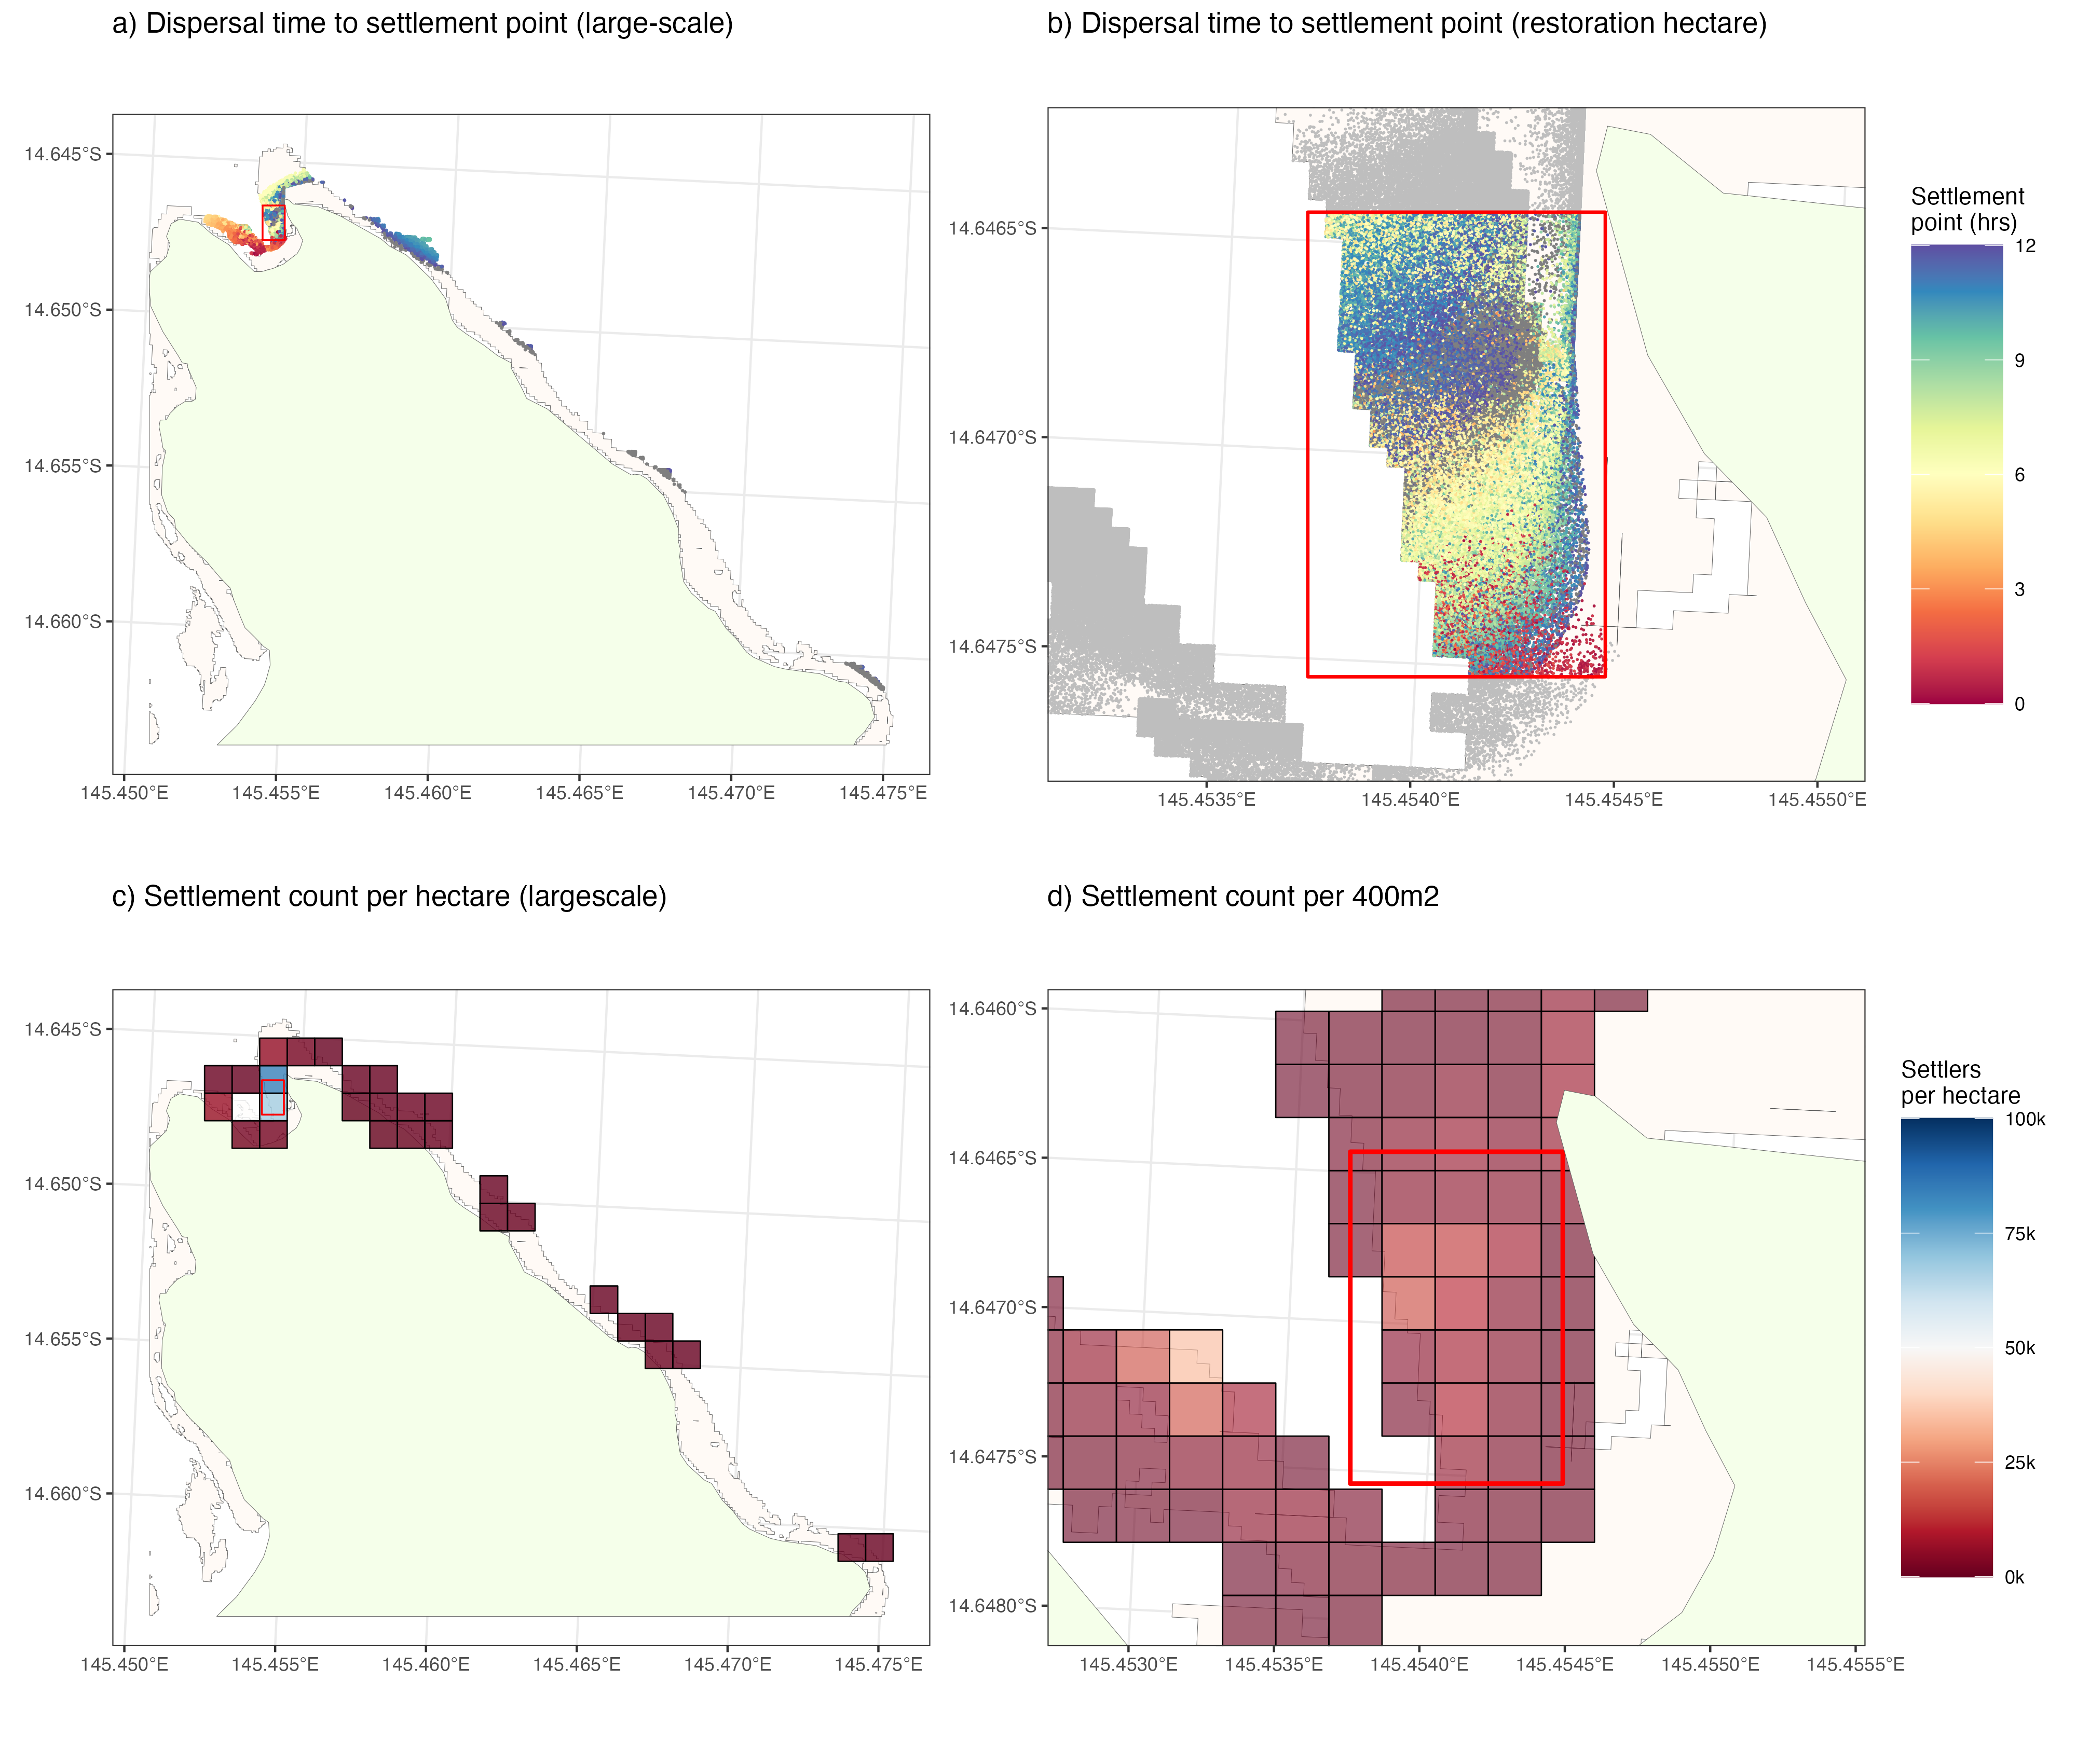
Part 1: Simulations
Mermaid Bay
Mermaid Bay

Slide 6
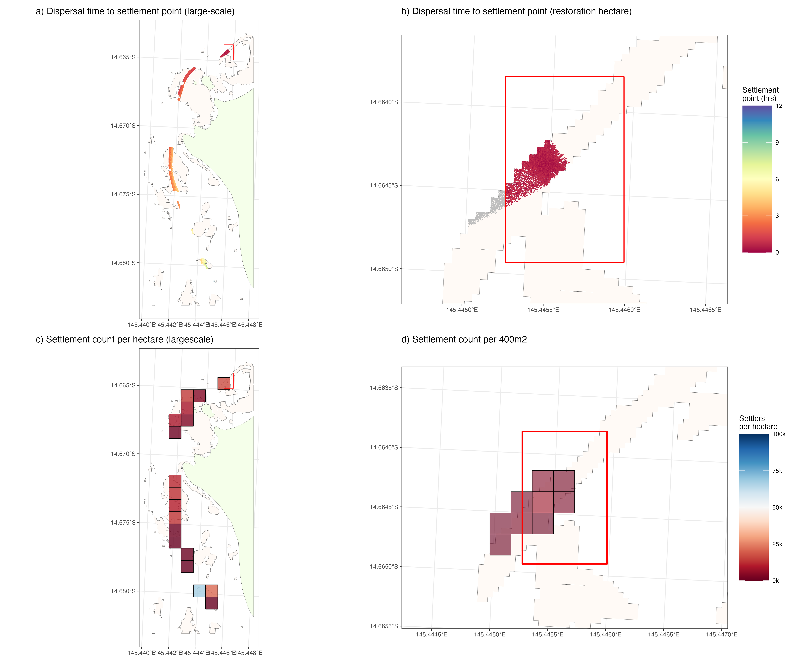
Part 1: Simulations
Osprey Reef
Osprey Reef

Slide 7
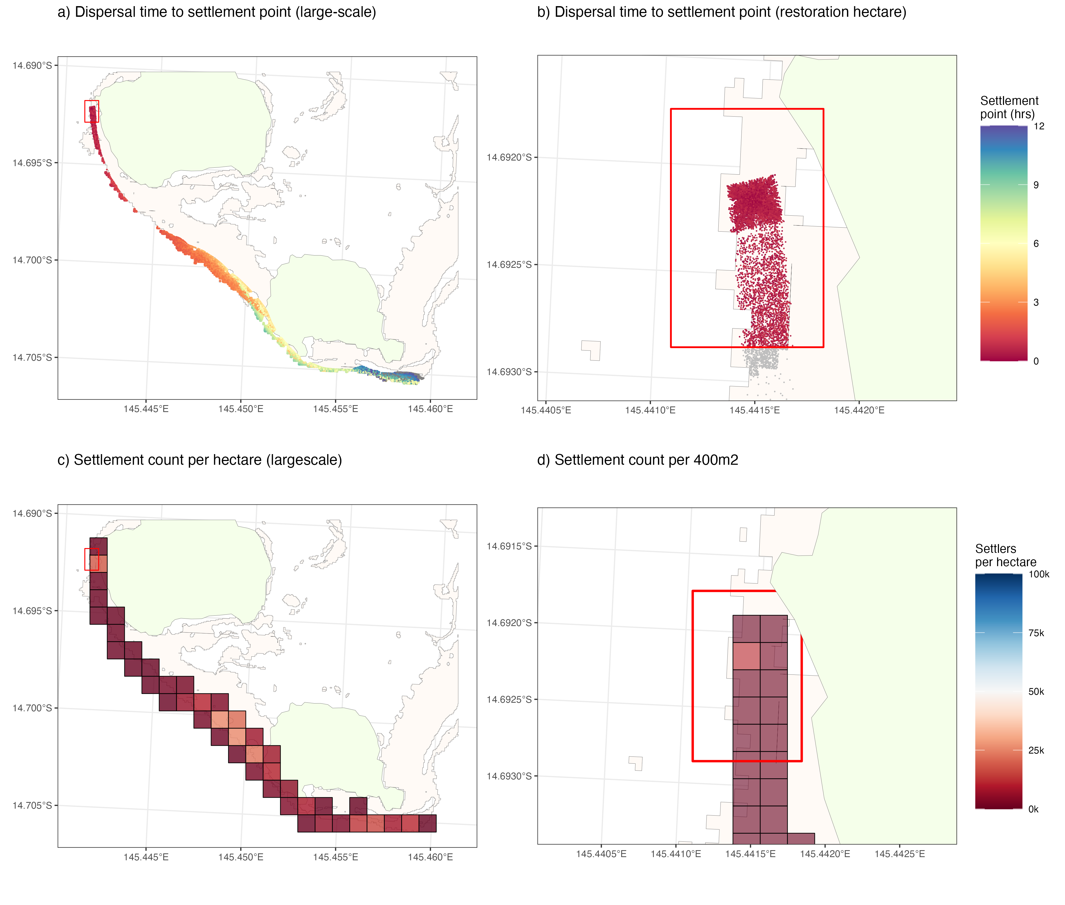
Part 1: Simulations
Palfrey Reef
Palfrey Reef

Slide 8
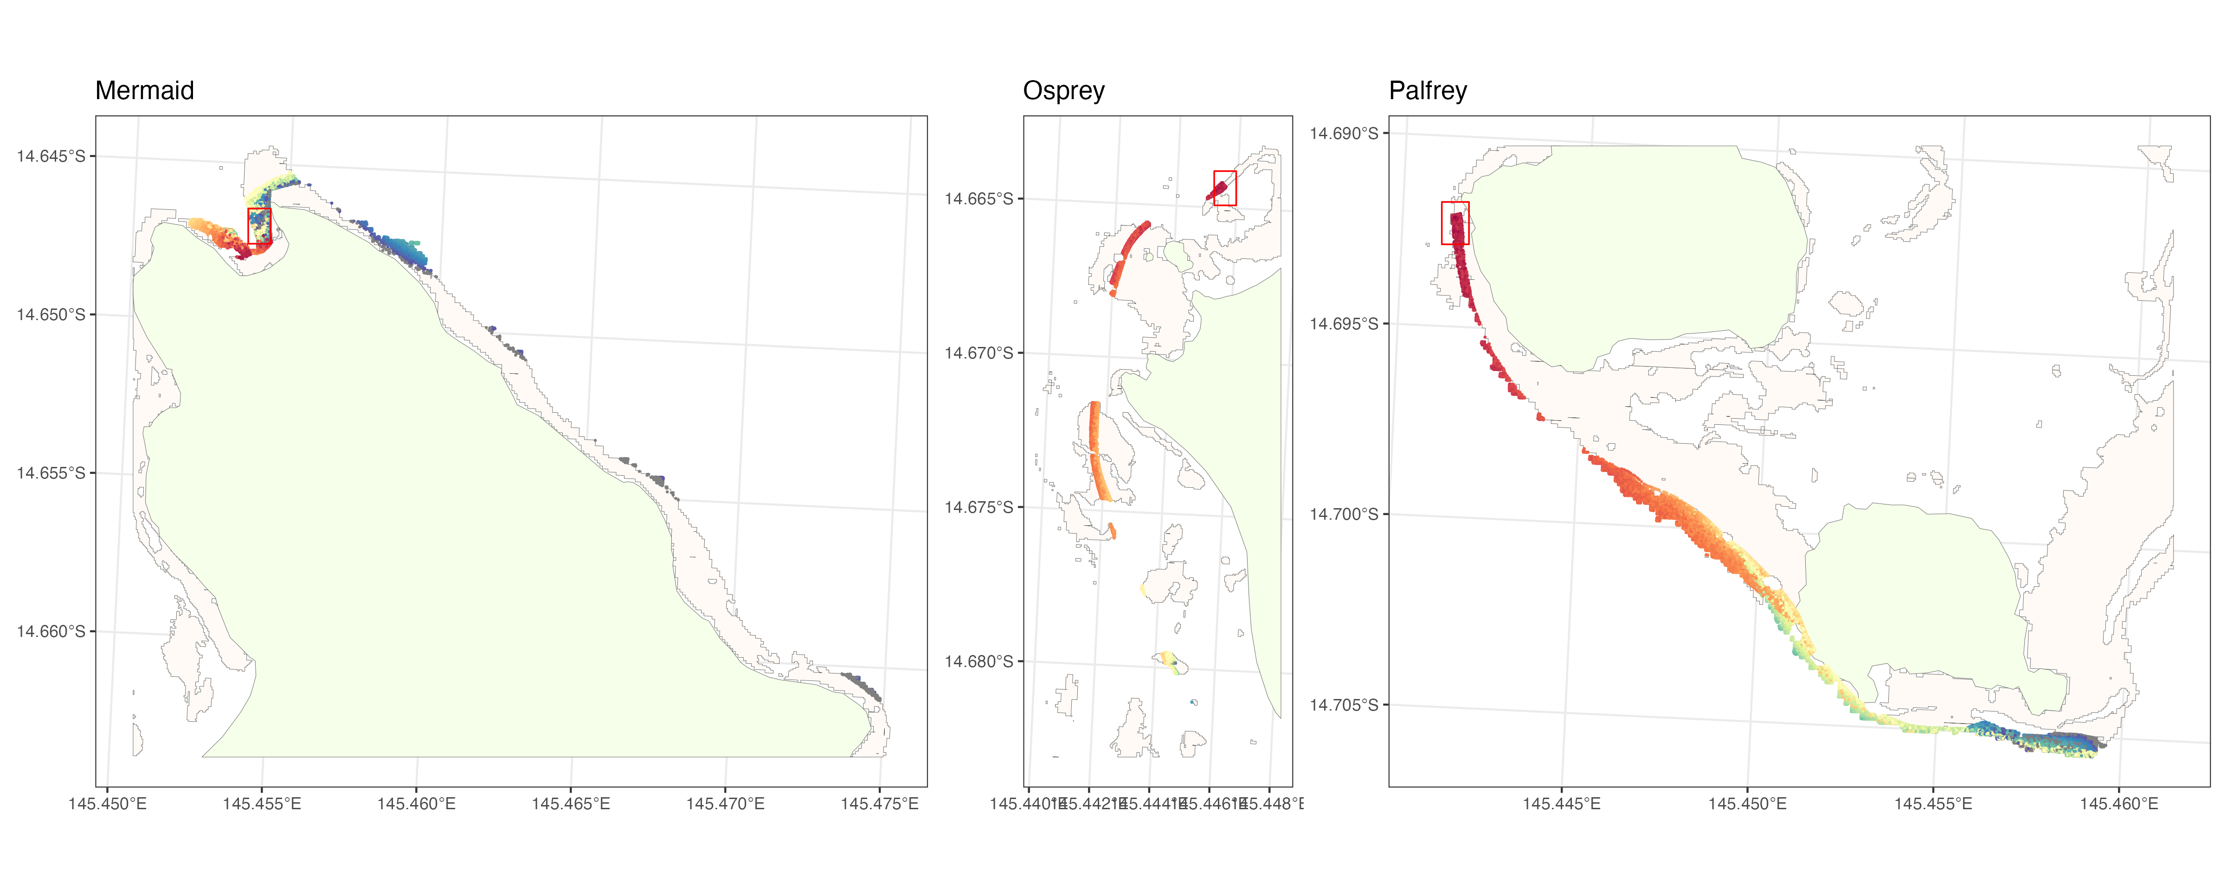
Part 1: Simulations
High-level Summary points:

Slide 9
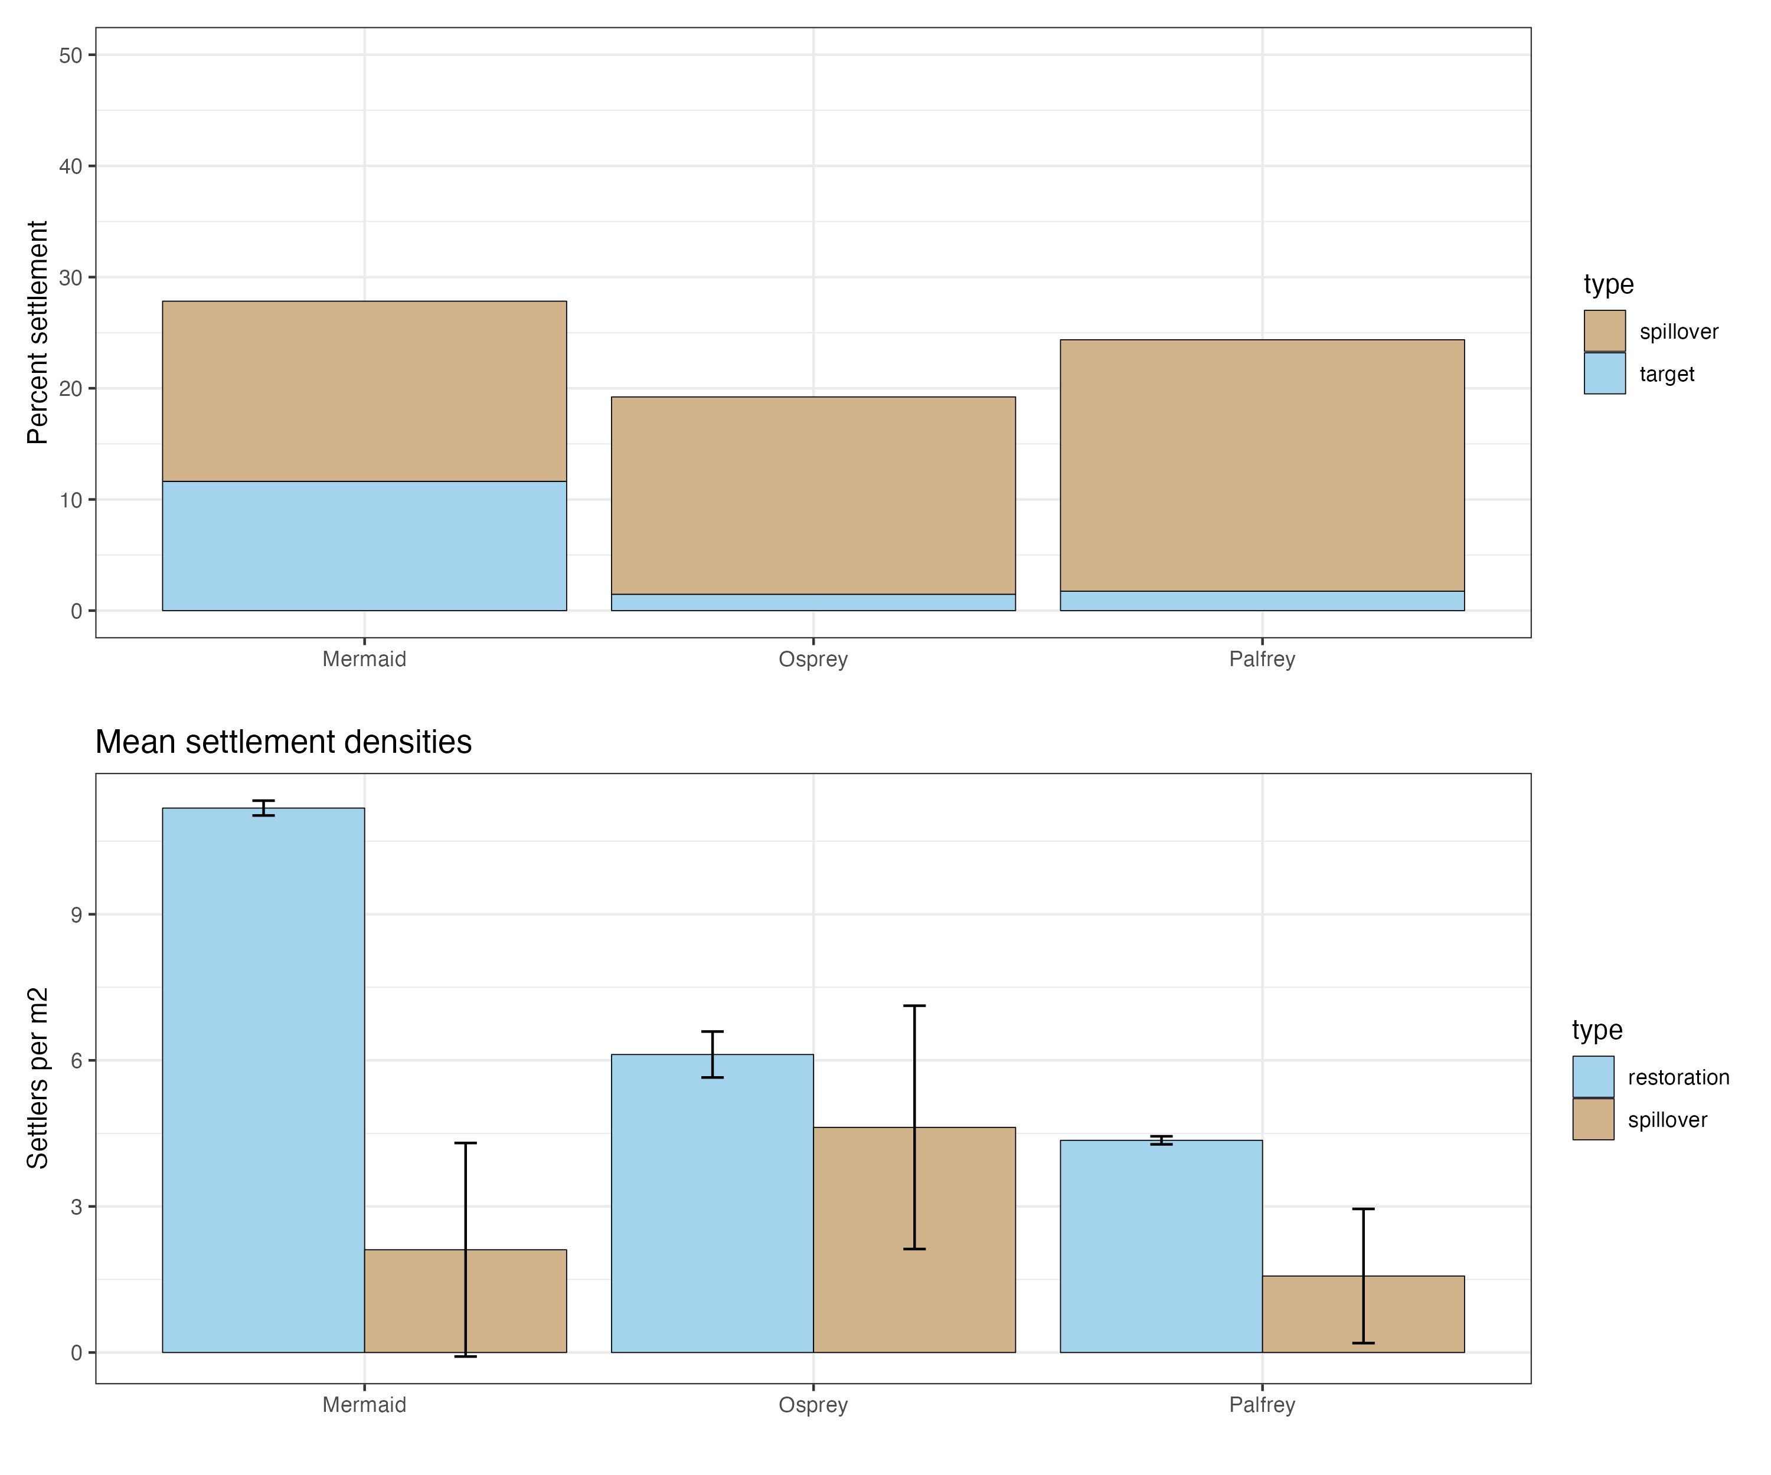
Part 1: Simulations
High-level Summary points:
Similar settlement across all sites
Higher target settlement and less spillover at Mermaid (high retention)
Higher local settlement densities at Mermaid (high retention
Higher
local
settlement
58% of settlers
42% of settlers
92% of settlers
93% of settlers
8% of settlers
7% of settlers
10 million larvae released at each site
Target densities:
Mermaid: 1,162,800 settlers = 116 per m2
Osprey: 146,870 settlers = 14.6 per m2
Palfrey: 174,390 settlers = 17.4 per m2
Larvae needed for 1000 settlers per m2 over target restoration area:
Mermaid = 86,206,897 larvae
Osprey = 684,931,507 larvae*
Palfrey = 574,712,644 larvae*
* does not account for spillover

Slide 10
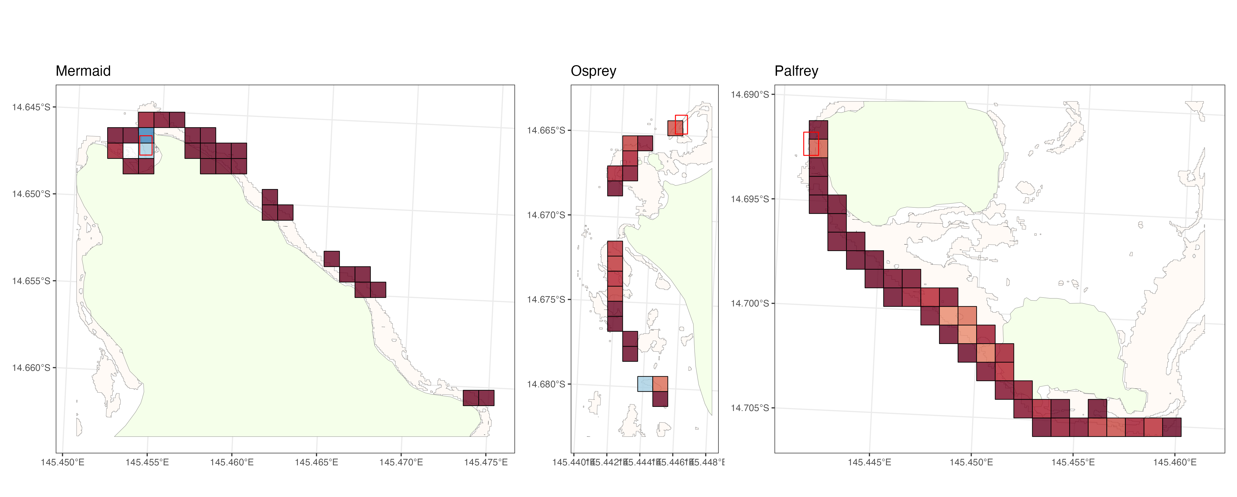
Part 1: Simulations
High-level Summary points:
Conclusions
Huge numbers of larvae needed for high densities unless optimal hydrodynamics /retention
Local retention key for retaining larvae long enough to reach competency
Focus less on targeted restoration and more on spillover densities
Seascape pattern key to determining spatial footprint in high dispersal scenarios (area of habitat and habitat-specific settlement preferences)

Slide 11
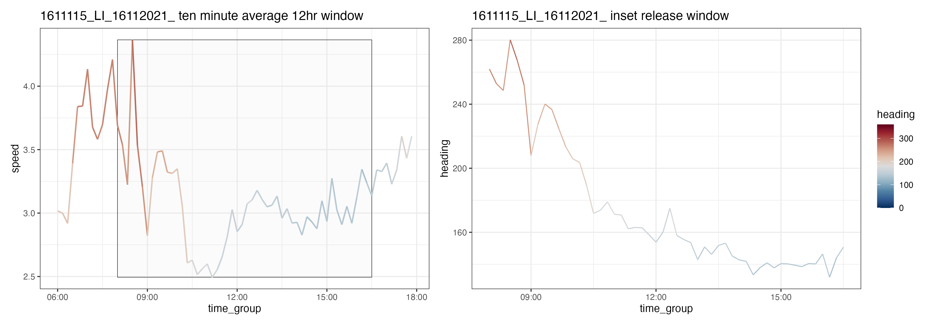
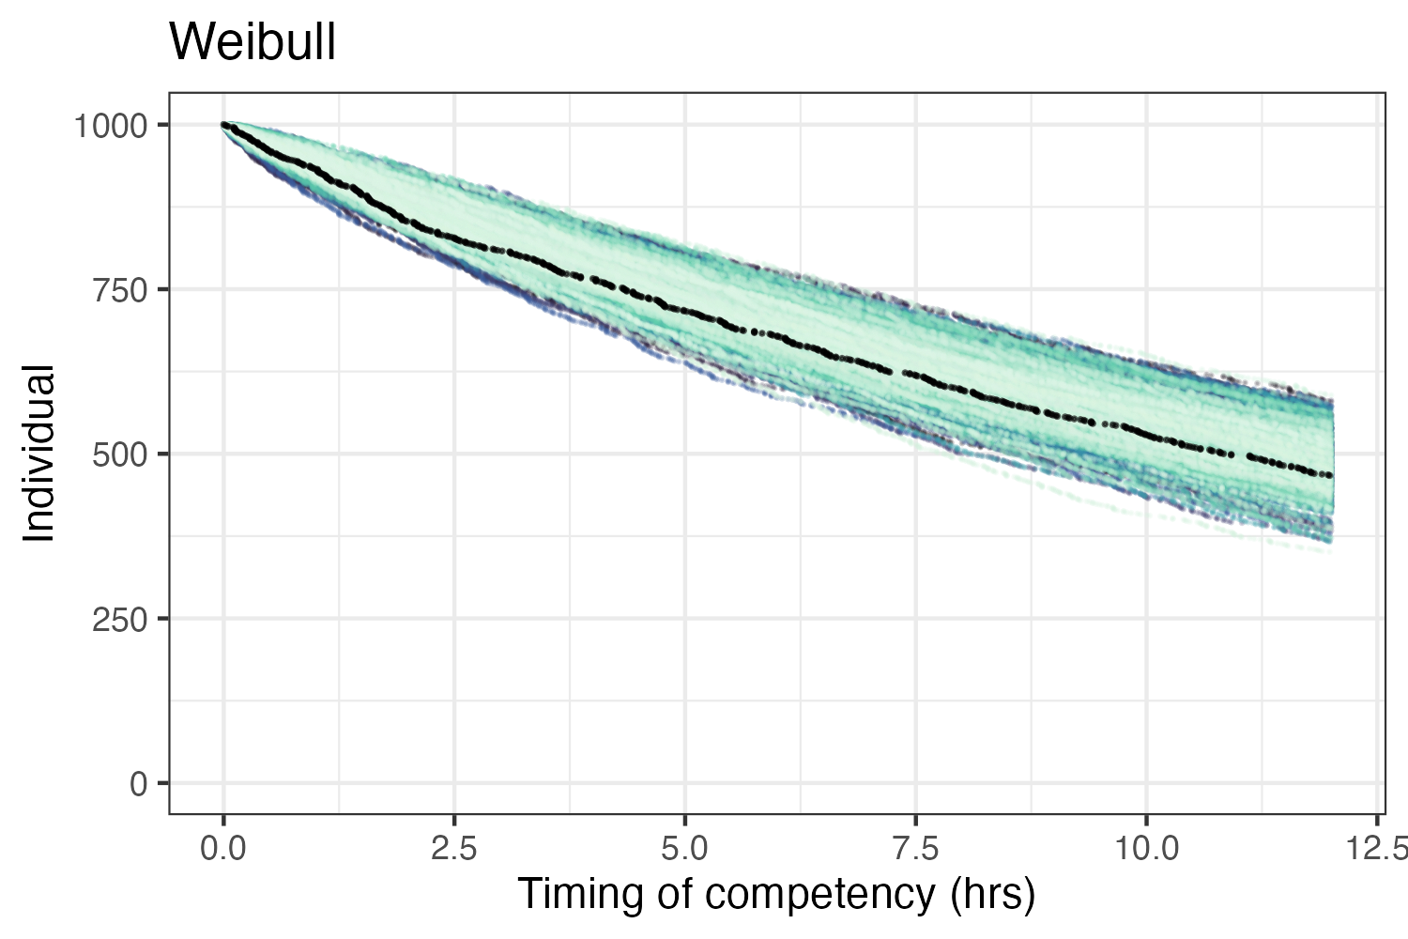
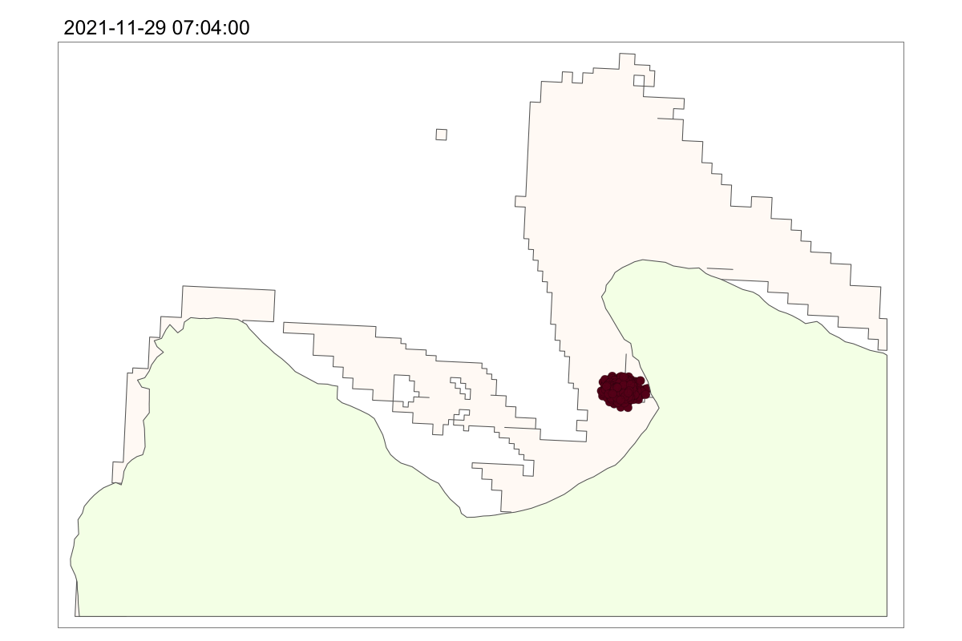
Part 1: Simulations
Appendix: Simulated 2D-dispersal model
Current meter - Mermaid Nov 2021
Larval settlement kernel
langrangian
Developed for testing small-scale simulations, not ecologically valid
Approach:
1 million simulated larvae released from a point source
Particles adopt velocity and direction from current flow
“Uncertainty” in trajectories incorporated from variance
Future changes?
Currently no boundary conditions, but multiple loggers allow for interpolation field
No 3D depth or “rules” for hitting boundaries…

Slide 12
Part 2: Interventions
Huge numbers of larvae needed for high densities
Local retention key for retaining larvae long enough to reach competency
Understanding larval retention and local hydrodynamics priority in optimize larval releases (Gouezo et al … )
Can interventions enhance settlement or constrain hydrodynamics to optimize local settlement?
Simulated Scenarios:
Increasing settlement rate (elevated temperature, prelease incubation in CCA cues)
Increasing retention (bubble curtains)
Delayed deployments (seedbomb)
Interventions could expand larval re-seeding toolbox to operationally challenging environments (e.g. forereefs)

Slide 13
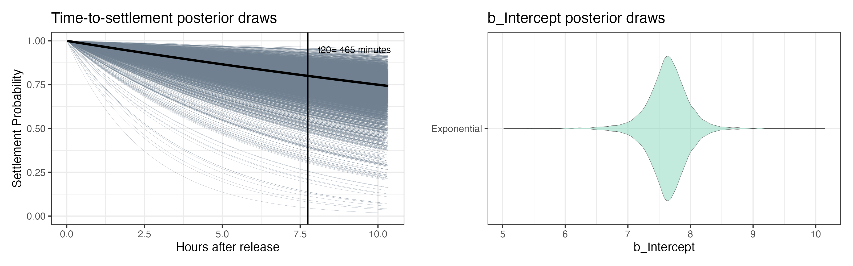
Part 2: Interventions
1) Accelerating competency and settlement
Current parameterization for settlement
S(t)=exp(−λt)
Temperature (e.g. Nozawa & Harrison 2007) and larval cues (e.g Koehl & Hadfield 2004, Randal et al 2024) induce accelerated settlement rates
Can interventions (e.g. +2°C temperature during culture or incubation in CCA extract prior to release) improve the efficacy of larval restoration?

Slide 14
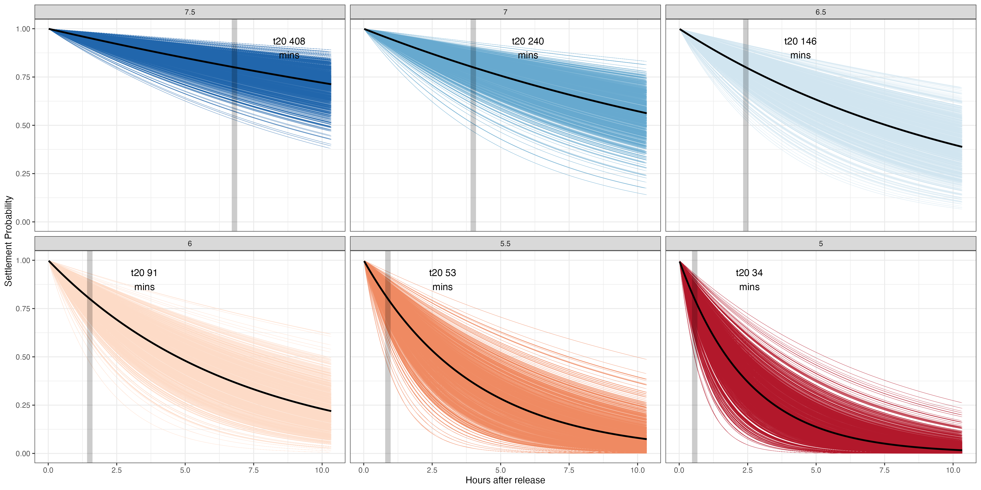
Part 2: Interventions
1) Accelerating competency and settlement
Exponential settlement models: lower b_Intercept = improved competency (rate and total number)
Use b_Intercept values to simulate intervention strengths
x2 competency
x3 competency
28% settlement
43% settlement
61% settlement
x5 competency
x9 competency
x14 competency
61% settlement
92% settlement
98% settlement
Competency (s²⁰) = time taken for 20% of larvae to settle, t¹² = settlement by 12hrs
Includes endogenous mortality – changing b_Intercept affects t¹²

Slide 15
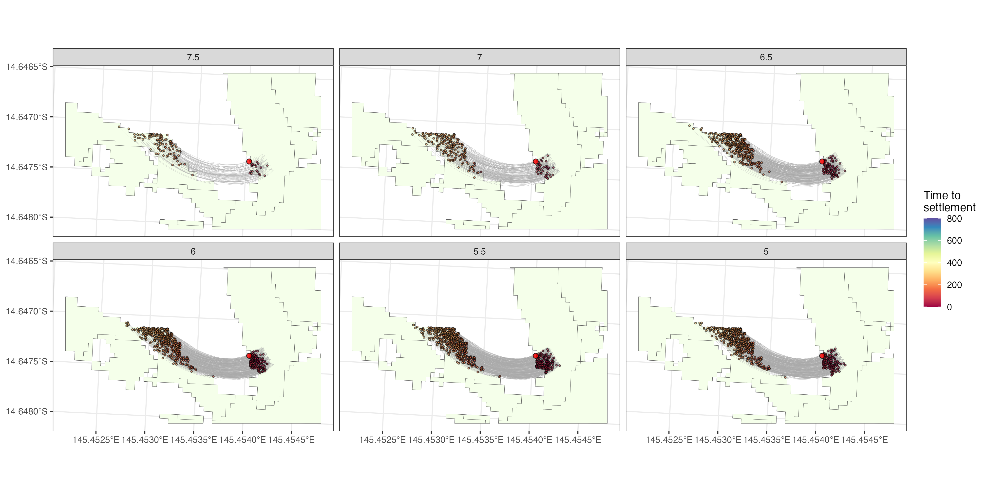
Part 2: Interventions
1) Accelerating competency and settlement
Mermaid Bay settlement under varying levels of accelerated competency (b_Intercept)
x2 competency
x3 competency
x5 competency
x9 competency
x14 competency

Slide 16
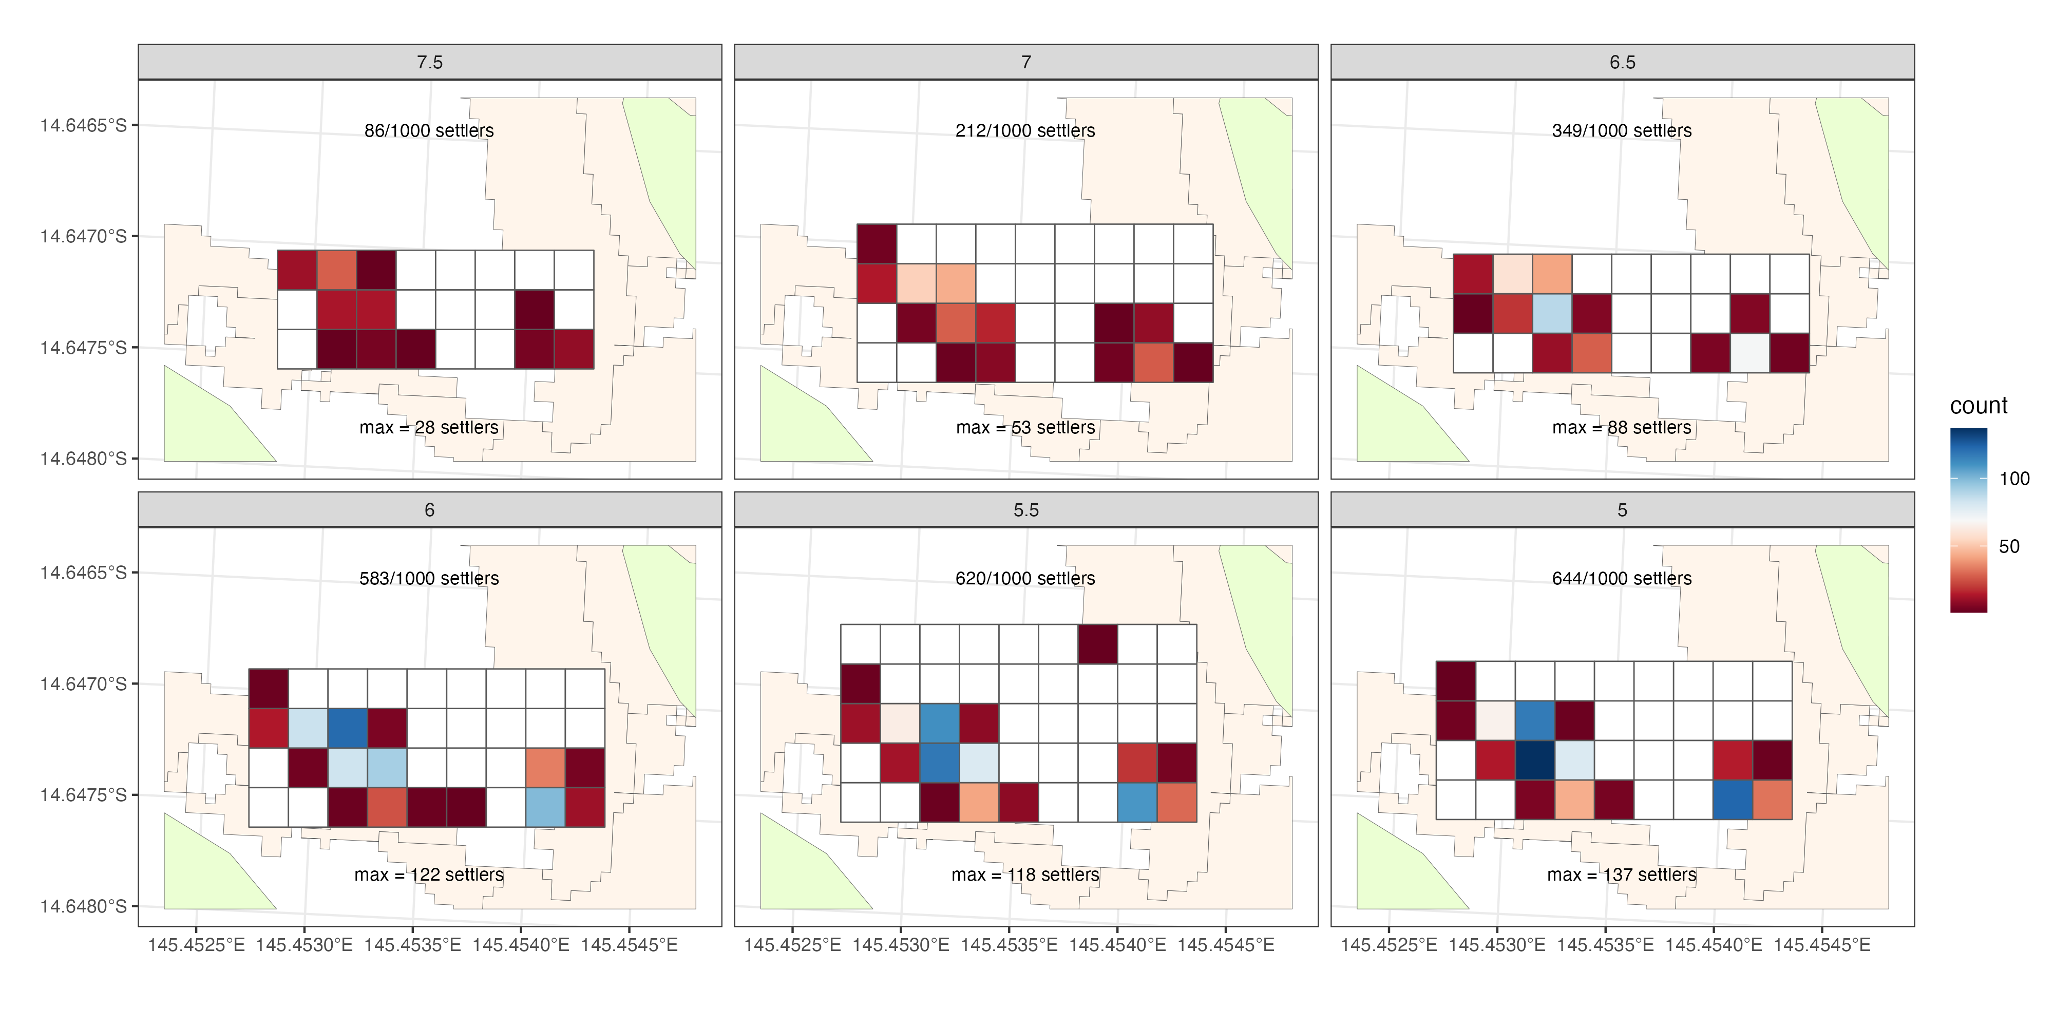
Part 2: Interventions
1) Accelerating competency and settlement
Significant improvements in restoration outputs in terms of i) total settlement, ii) spatial footprint (number of 20m gridcells), iii) settlement density within cells
x4 increase in settlement potential

Slide 17
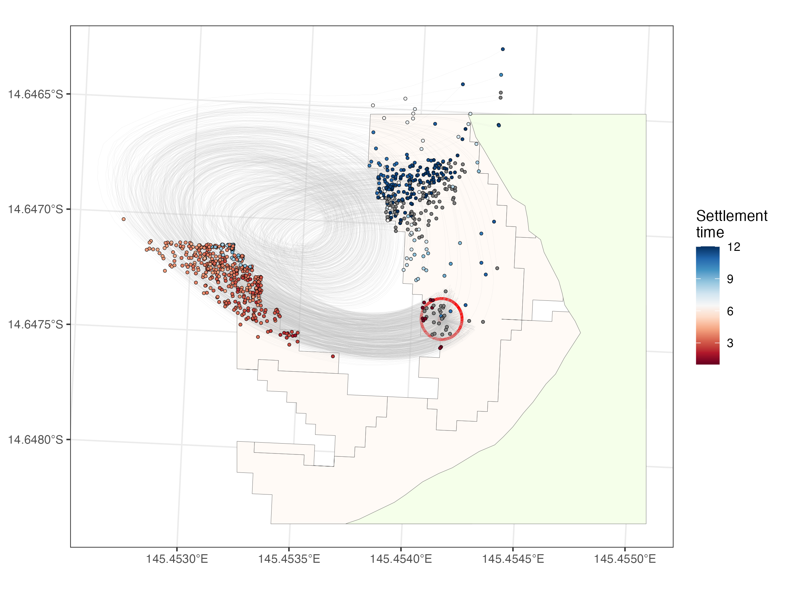
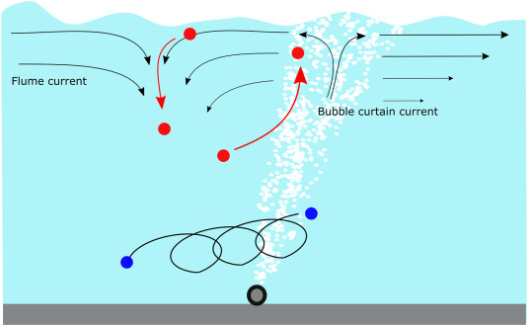
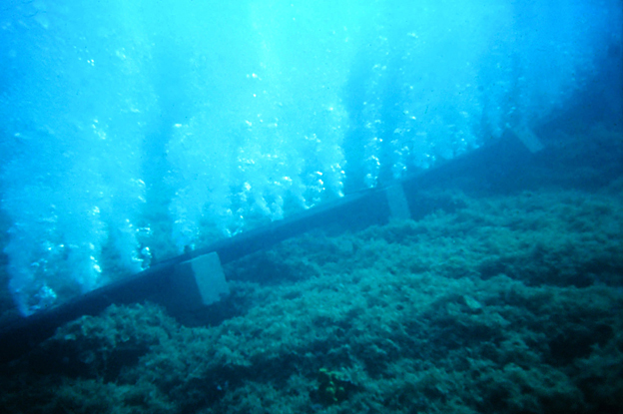
Part 2: Interventions
2) Artifical Larval retention
Simulated bubble curtain 20m diameter (62.8m hose length) at mermaid release site

Slide 18
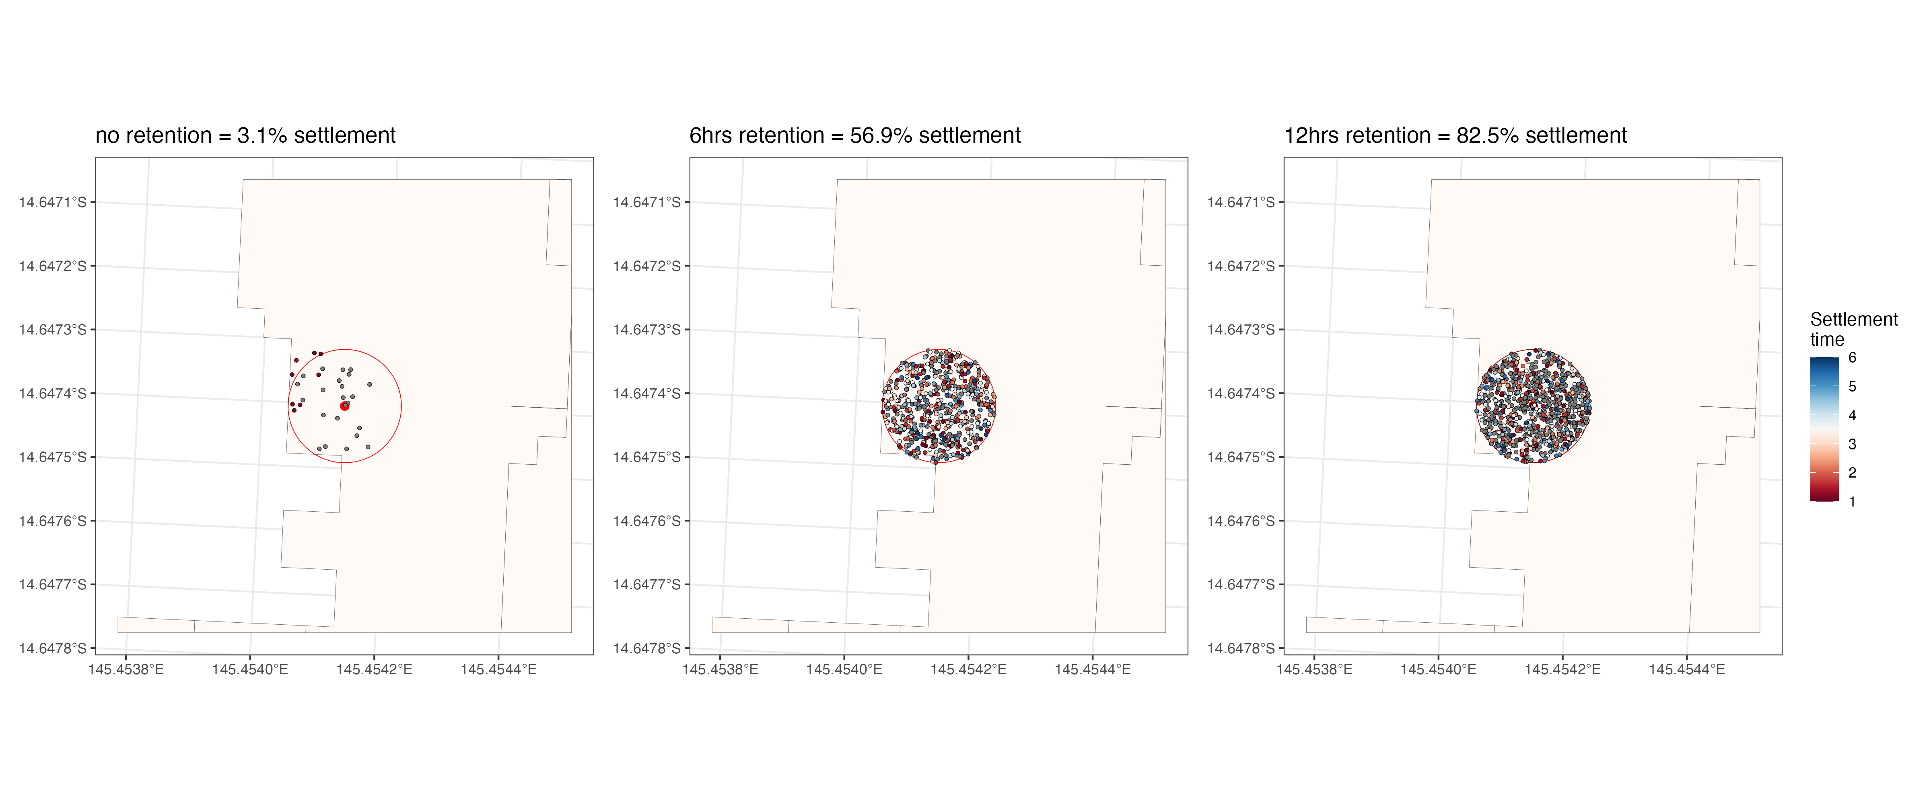
Part 2: Interventions
2) Artifical Larval retention
Artificial retention represents a significant improvement on settlement rates in target areas*
* the model assumes i) no loss via the curtain, ii) complete stability across the deployment period, and iii) random settlement within the curtain area

Slide 19
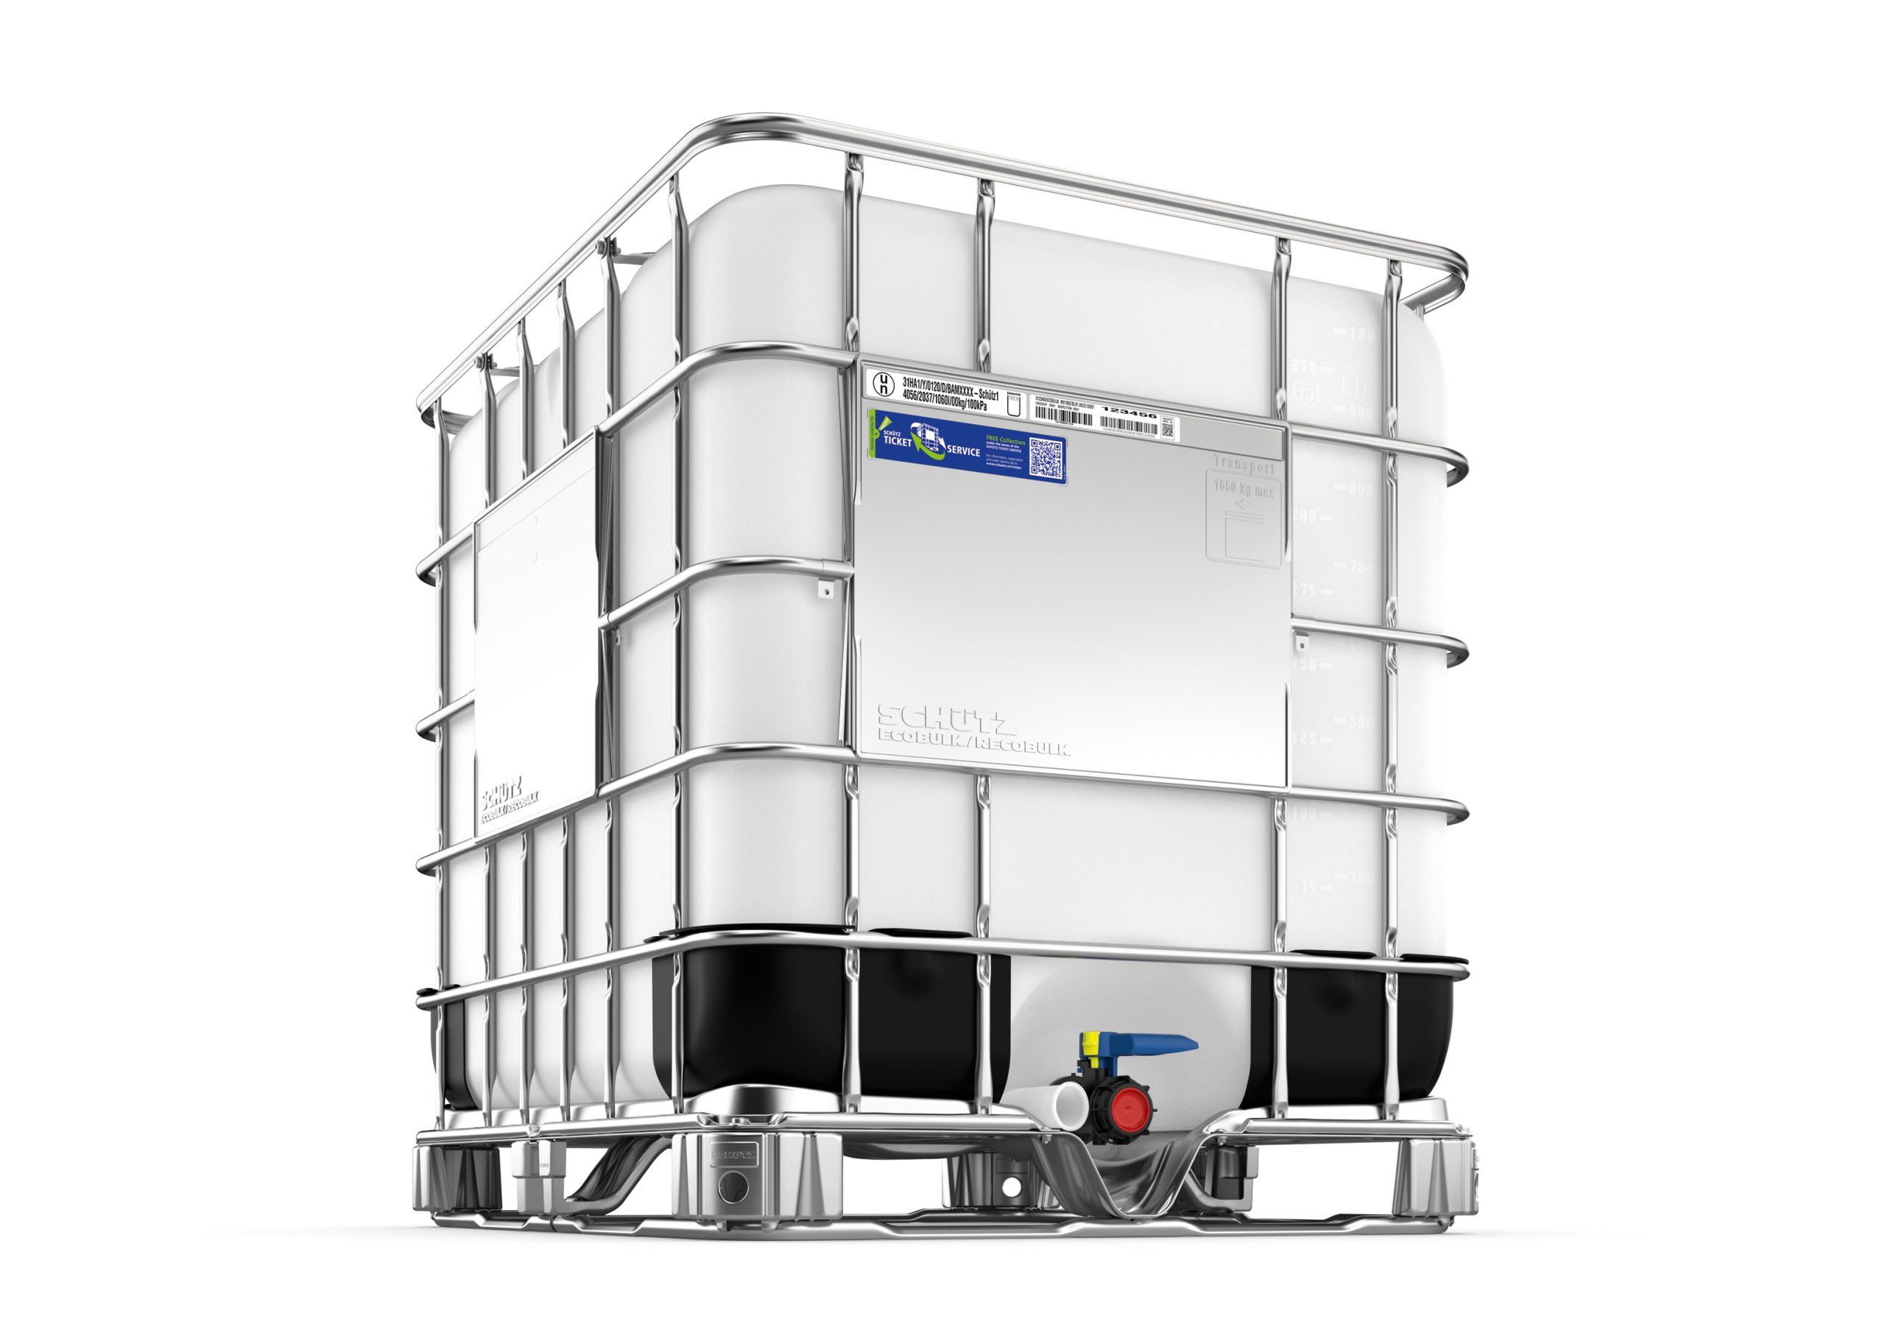
Part 2: Interventions
3) Time-delayed larval delivery*
Hypothetical scenario:
10e⁻⁶ larvae are deployed in a container at site
Container has holes allowing larvae to exit/disperse when competent
Larvae become competent within container over a 12hr period following exponential time-to-competency curve
Larvae are immediately competent at time of release (over the 12hr period)
Current cycle varies at time of release
Settlement then becomes a function of habitat probability
If p = 0 settlement larvae disperse to next habitat along dispersal paths
Example uses simulated dispersal model based on Mermaid Bay current meter data

Slide 20
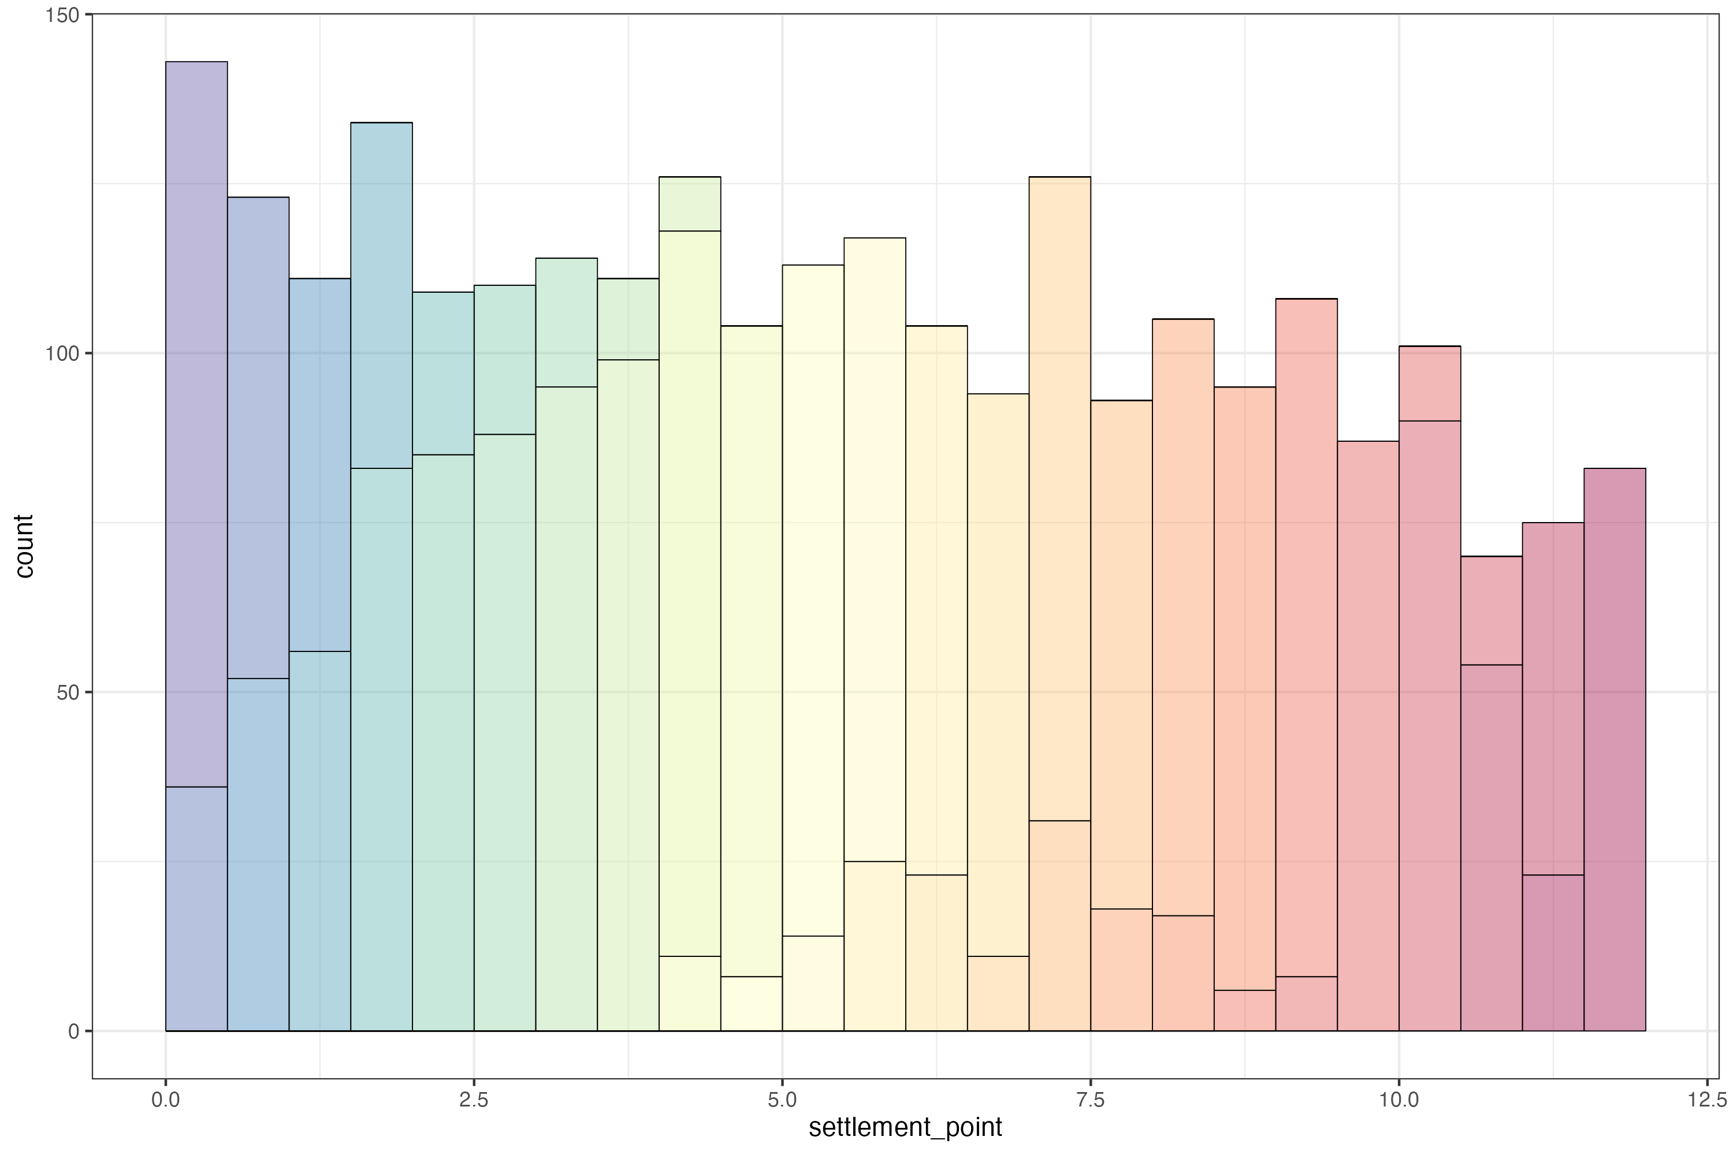
Part 2: Interventions
3) Time-delayed larval delivery*
Hypothetical scenario:
10e⁻⁶ larvae are deployed in a container at site
Container has holes allowing larvae to exit/disperse when competent
Larvae become competent within container over a 12hr period following exponential time-to-competency curve
Larvae are immediately competent at time of release (over the 12hr period)
Current cycle varies at time of release
Settlement then becomes a function of habitat probability at the adjacent release site
If p = 0 then larvae disperse and may settle within neighbouring habitats
Example uses simulated dispersal model based on Mermaid Bay current meter data
100k initial larvae, 38% settle within first 12hrs (exponential model)

Slide 21
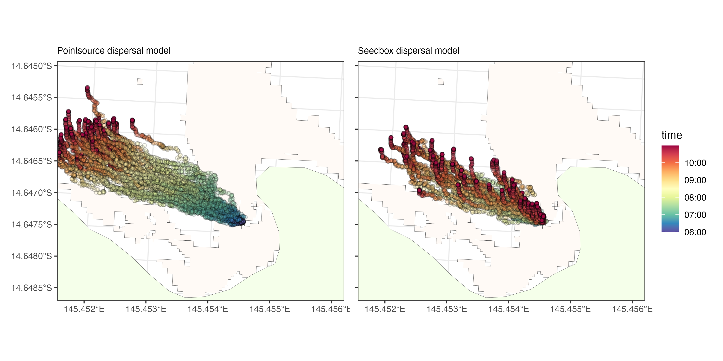
Part 2: Interventions
3) Time-delayed larval delivery – seedbox model

Slide 22
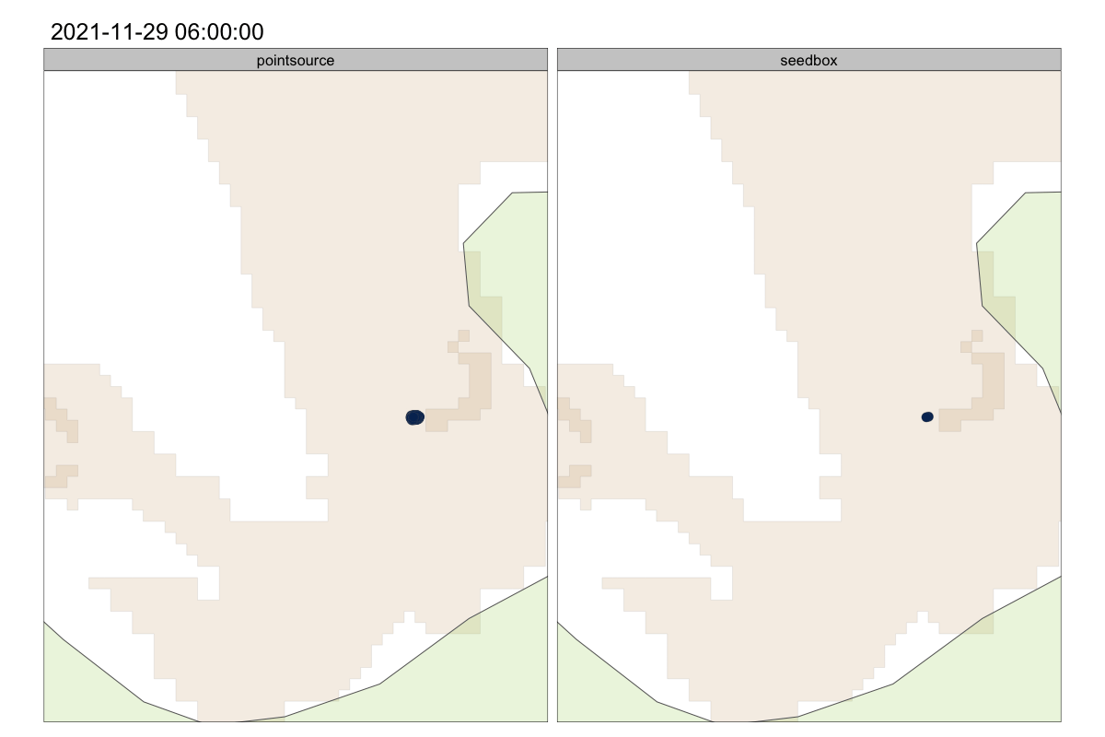
Part 2: Interventions
3) Time-delayed larval delivery – seedbox model
Close-up on release area

Slide 23
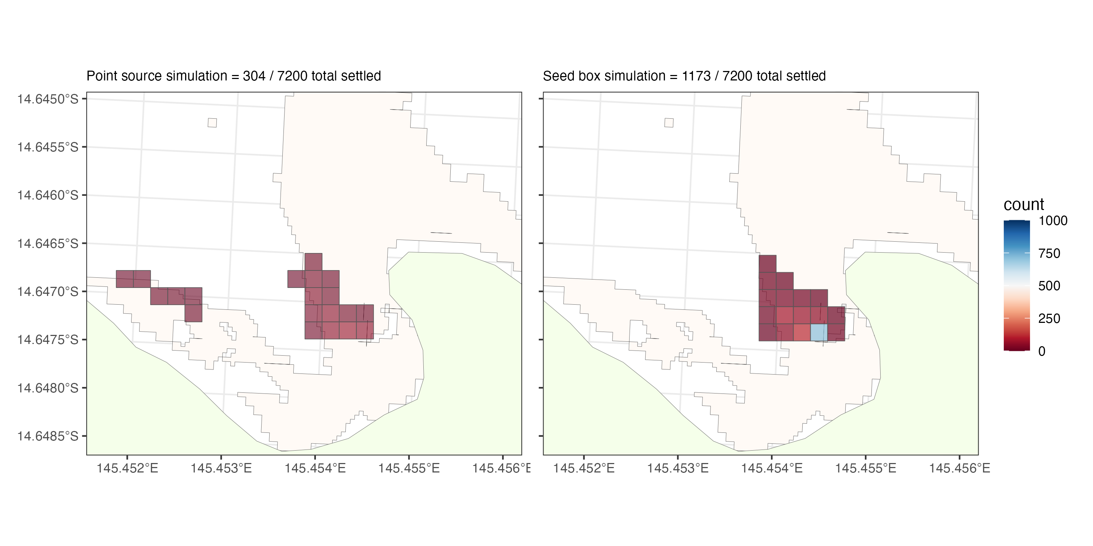
Part 2: Interventions
3) Time-delayed larval delivery – seedbox model
5-fold increase in local settlement
localised retention

Slide 24
Summary points
In optimal conditions of high retention industrial-scale production of larvae (~100 million) can result in an average settlement of 1000 larvae per m2 over a 1 ha plot (higher clustering within plot)
Substantial diffuse spillover effects can propogate low-density settlement across adjacent reefs
Low retention reseeding in high flow environments can broadly distribute larvae but with ecologically low densities
Interventions may substantially increase the efficacy of larval reseeding at sites
Simulation models indicate that interventions can a 4-40% increase in settlement over a “best case” optimal scenario

